Slide 1
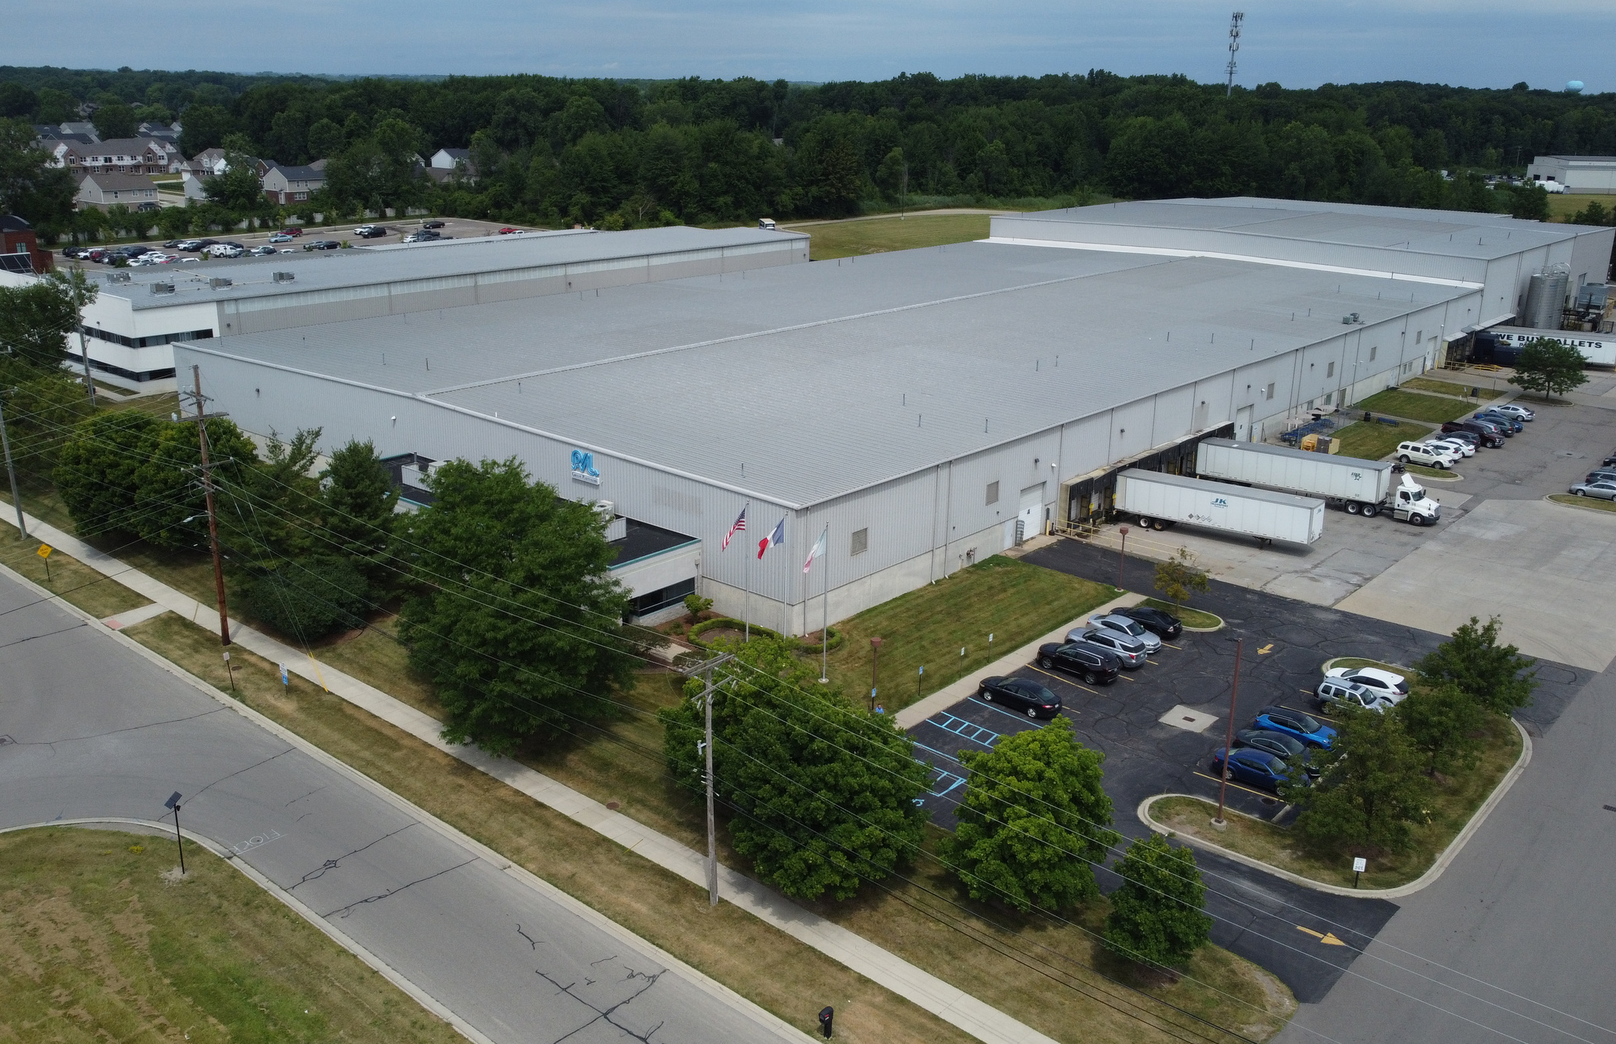


NORTH AMERICA

Slide 2


TABLE OF CONTENTS
  Company Overview
  Locations
  United States
  Mexico
  Company Objectives

Slide 3


Company Overview

Slide 4
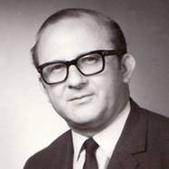
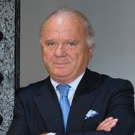
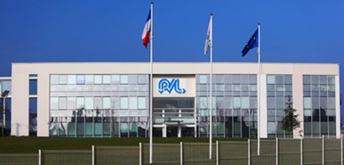
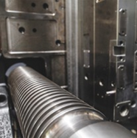
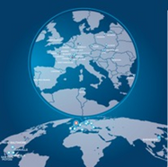

History
1963
Charles Findeling creates a plastics injection company in Langeais, France
1985
His son, Patrick Findeling, becomes CEO of the company
Group Sales Evolution (USD in millions)
1991
Stock exchange introduction of the Plastivaloire Group
1996-2000
Construction and acquisition of several sites in Poland, Romania, Tunisia, and France
2008
Acquisition of four Key Plastics sites
2011
Acquisition of the Bourbon-Fabi Group
2013
Test center and R&D Center created in Langeais, France
2014
Acquisition of the German plasturgist Karl Hess
2018
Acquisition of the TransNav company (USA + Mexico)
2020
Creation of Plastivaloire Pilsen Czech Republic
2022
TransNav company name changed to Plastivaloire America

Slide 5
GLOBAL
GROWTH STRATEGY
  Focus on 1/3 of the worldwide car volume and grow revenue per vehicle with our current products
  Reduce the overall dependency on the European automotive business
  Develop the Group footprint outside of Europe to:
Support local production of our main European customers, while simultaneously growing our American customers.
Be prepared to obtain a partnership in China to support our customers.
Continue to balance the Group sales ratio between automotive and industrial products.

Slide 6
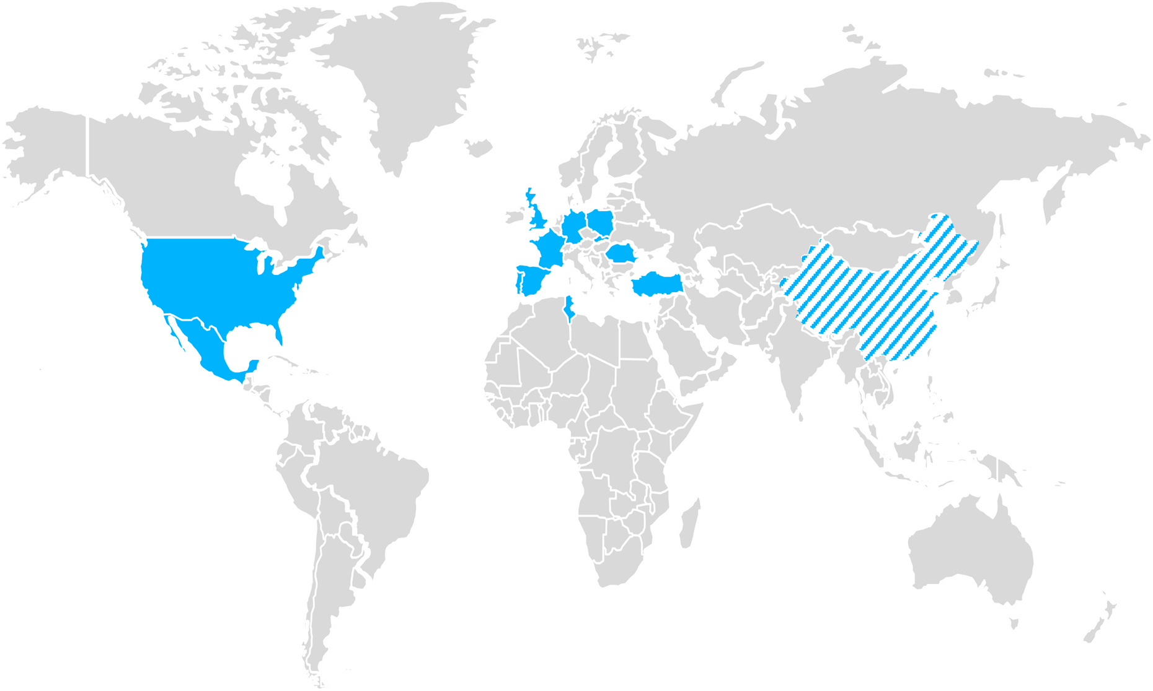


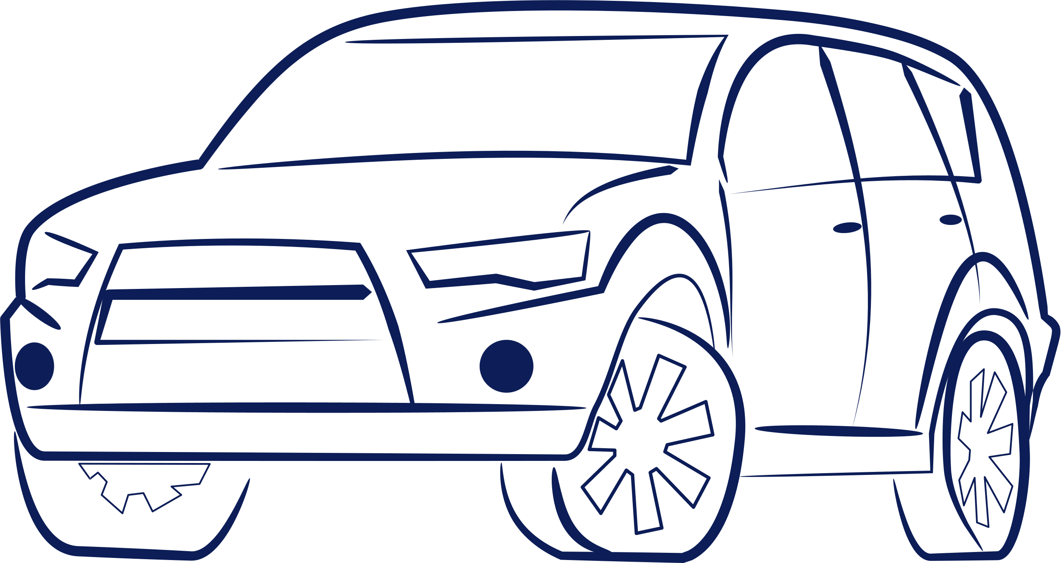
2021: $712M in Sales
Europe - North Africa
27 Manufacturing Sites
North America
4 Manufacturing Sites
China
1 Tooling site and 1 JV
4 Engineering Centers
340 Employees in Engineering & Project
20 Employees in Research and Development
80%
20%
6,000+ Employees
Two Market Segments:
Automotive & Industry

Slide 7

Key Products Split - Automotive

Slide 8
OEM Sales – Global View
Total Sales Segment Split
8

Slide 9
Manufacturing Capabilities

Slide 10
NORTH AMERICA
GROWTH STRATEGY
  Develop new markets : EV, Heavy Trucks, new OEM, Industry
  Increase offer content : decoration, complex assembly, innovative materials
  Develop the Group footprint in the United States and Mexico
  Increase focus on large tonnages >1500T and 2K – 3K
  Sustain a financial healthy situation to support Customer development needs
Support local customers with local engineering for their product and processes
Be prepared for external growth or new green field
Develop partnership in decorated parts and be ready for in house process
products.

Slide 11
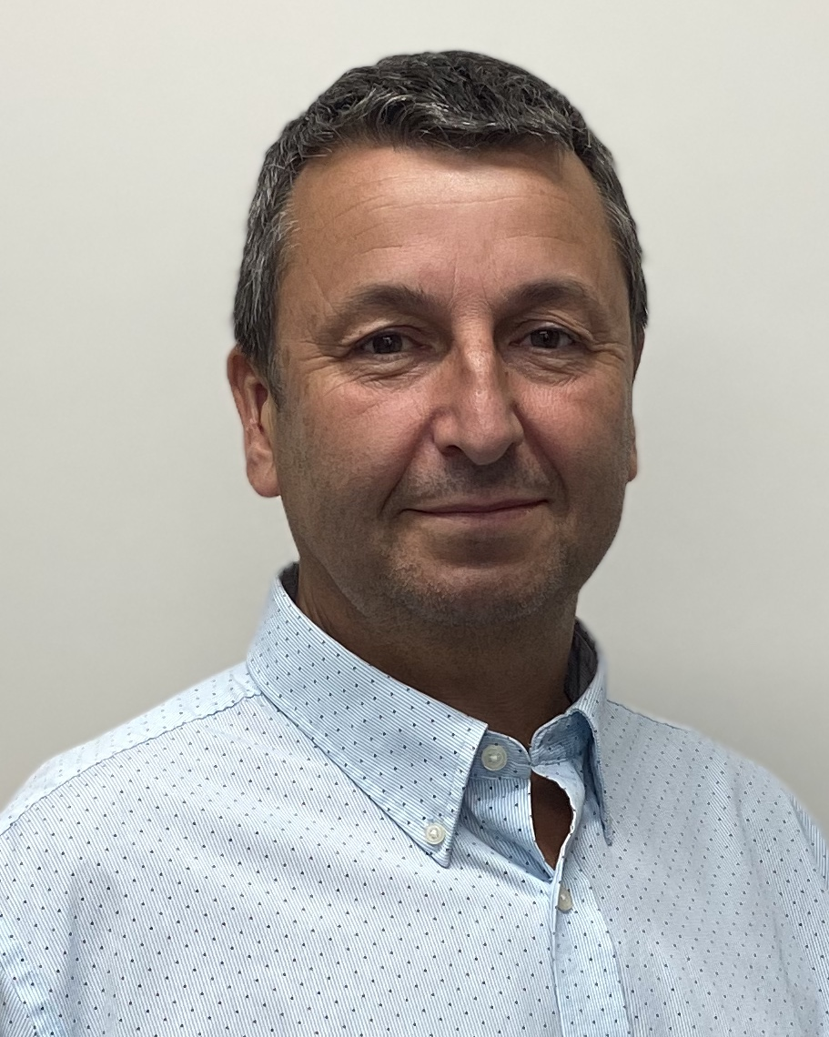
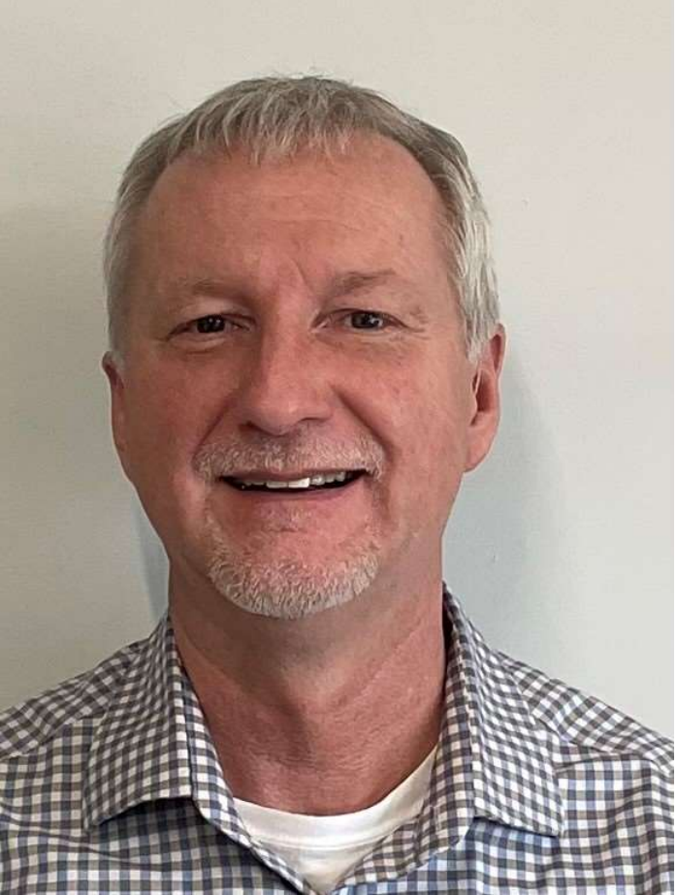
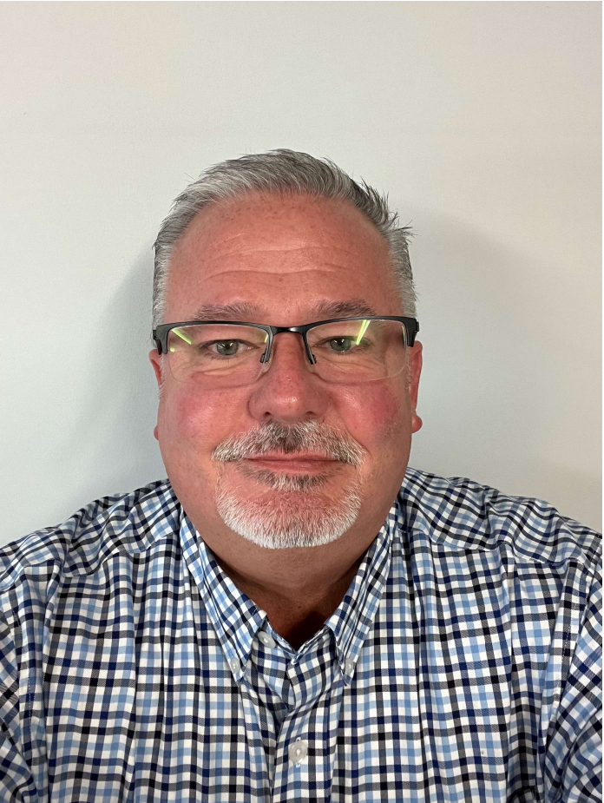
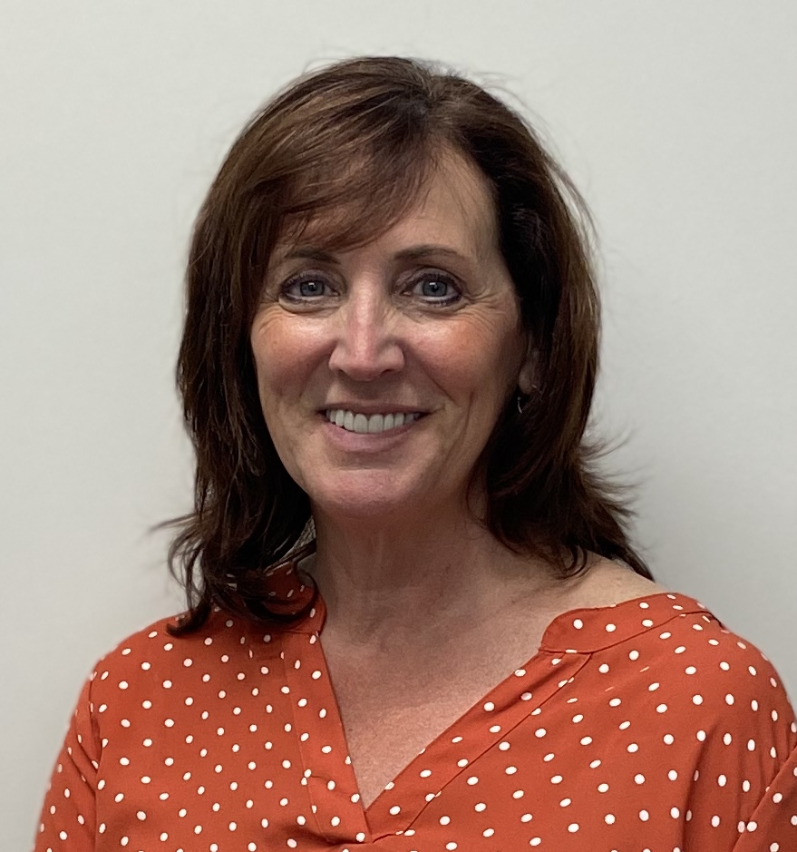
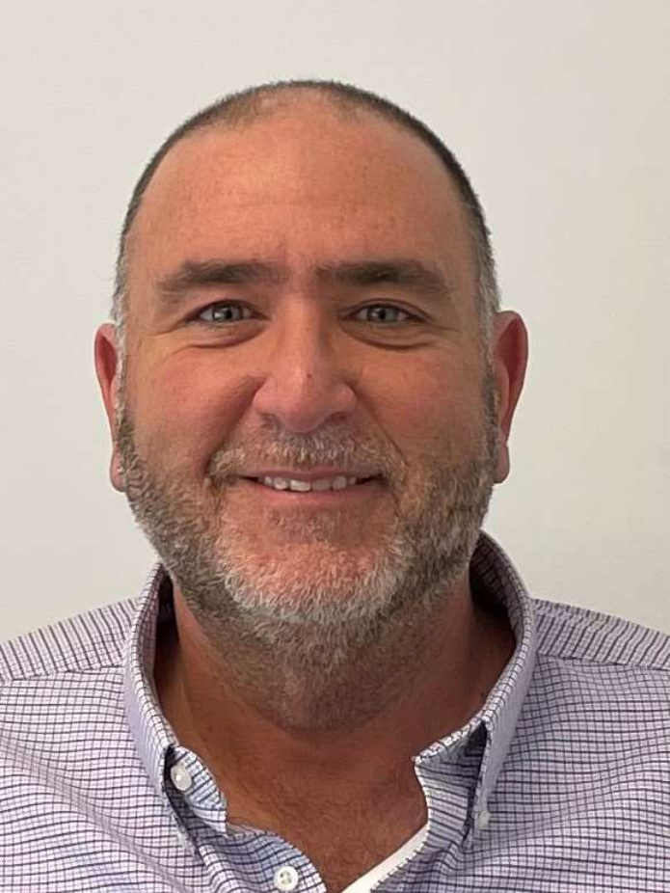
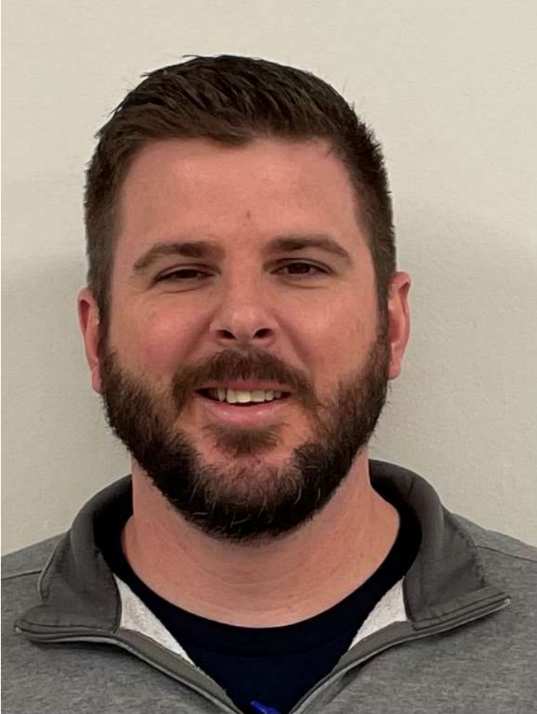
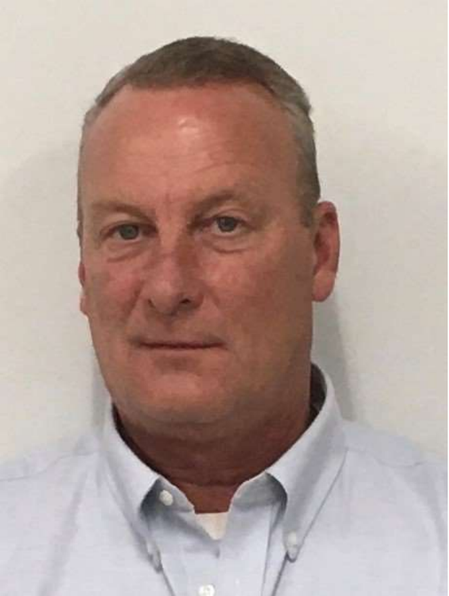
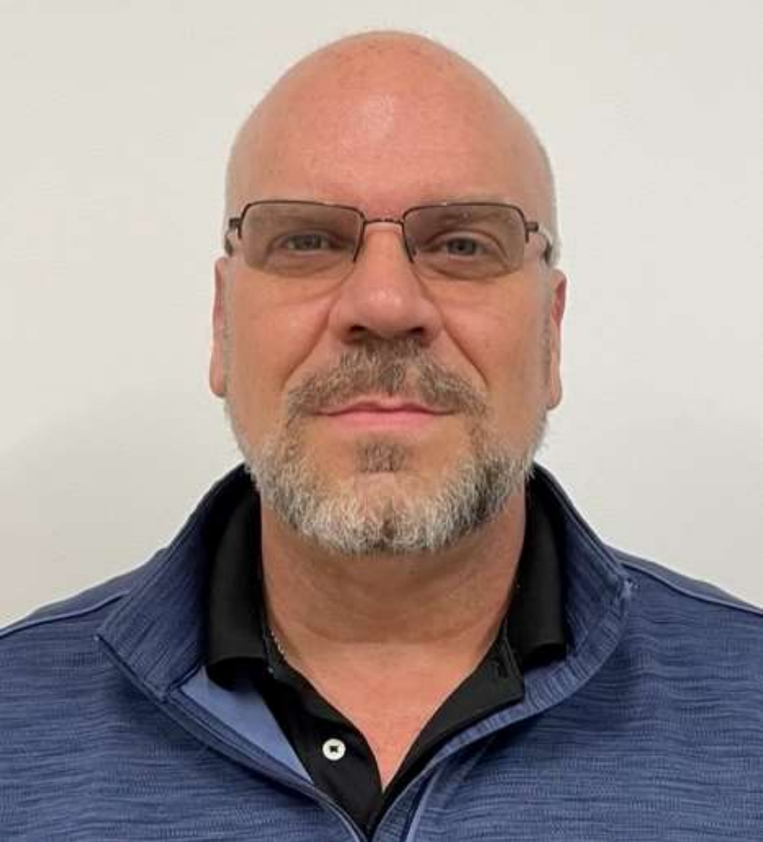
Meet the North America Management Team
Eric Le Bozec
North America Managing Director
Troy Swalwell
Finance
Tim Nixon
Engineering
Heather Pasquinzo
Business Unit Mgr
Tom Pagano
Purchasing
Garry Allen
Quality
Bob Pate
NB Operations
Russ Catron
KY & MEX Operations

Slide 12
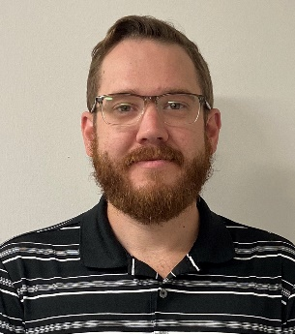
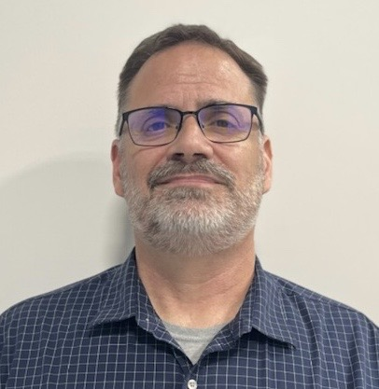
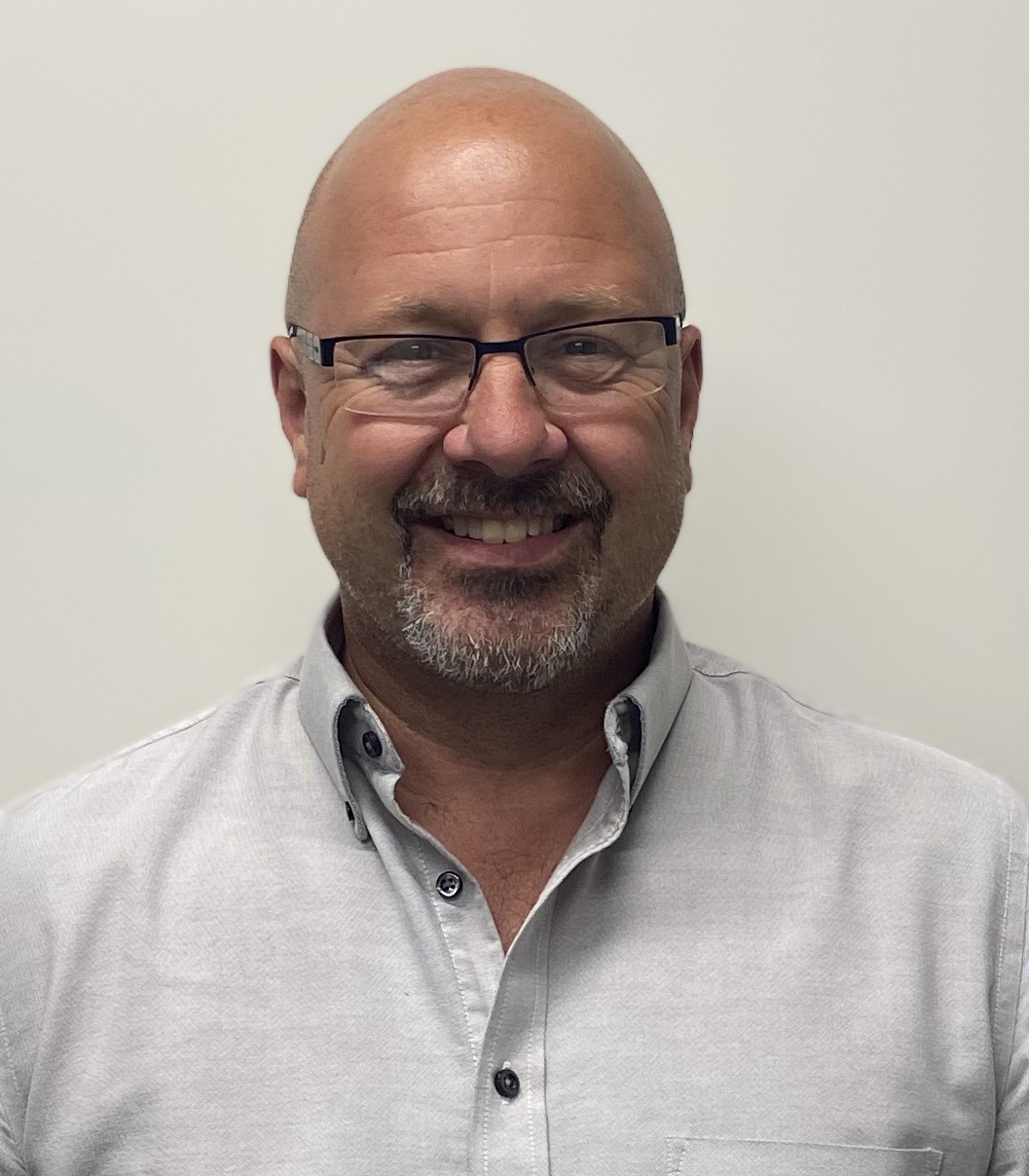
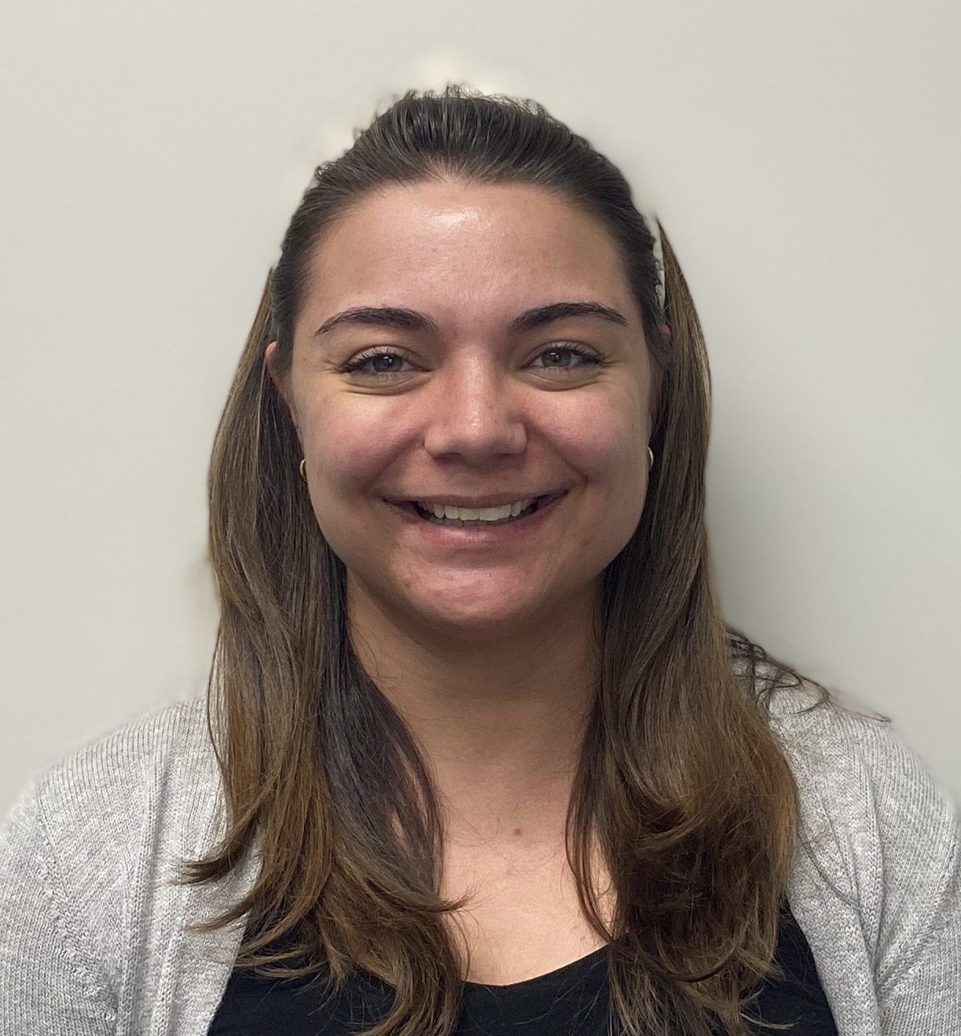
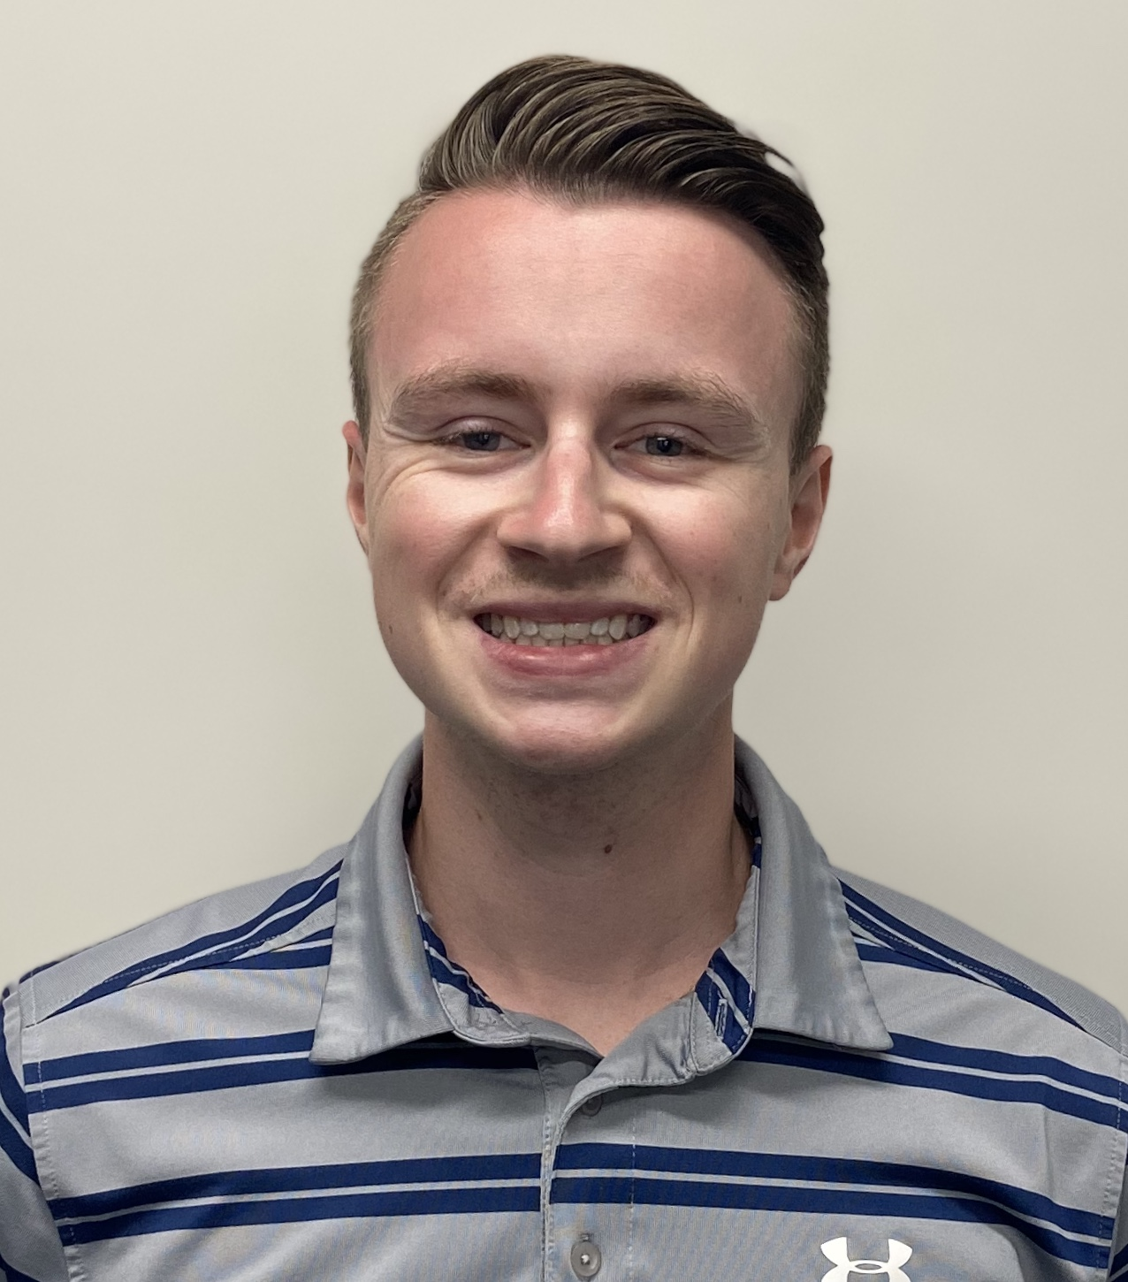
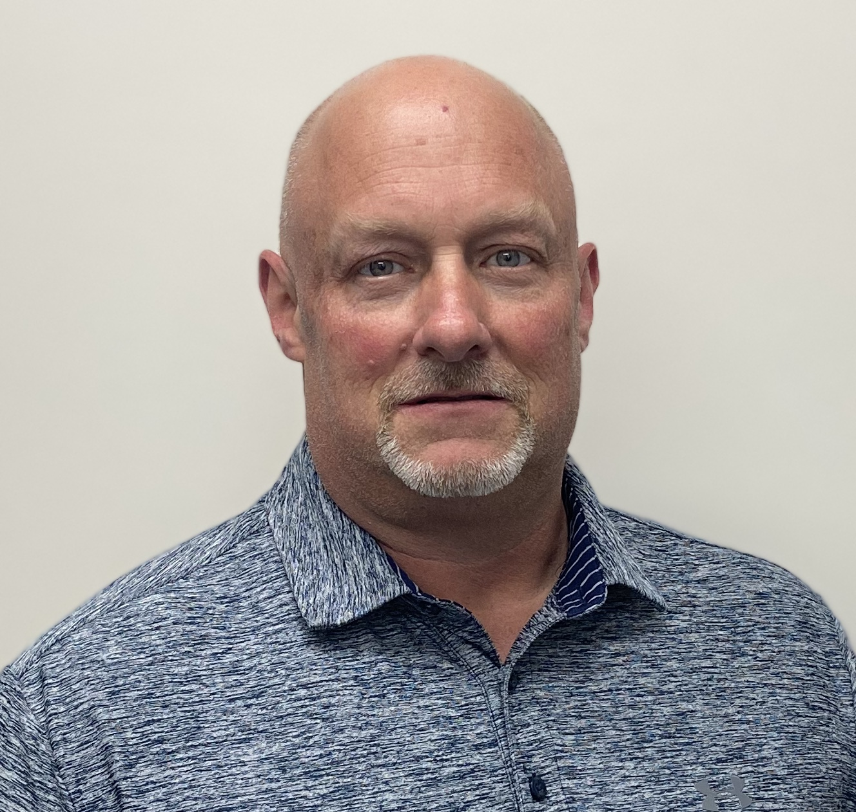
Meet the Sales and Program Management Team North America
TBD
Account Manager
Chris Hines
Account Manager
Aaron Prout
Program Manager
Scott Armstrong
Key Program Manager
Eric Le Bozec
GM NA
Heather Pasquinzo
BU MGR NA
April Briones
Packaging Engineer
Josh Covault
Account Manager
Scott DesAutel
Account Manager
TBD
Sales Associate

Slide 13


San Luis Potosí, Mexico
Auburn Hills, Michigan
Production Center
110,000 sq/ft
Plastivaloire America Company Headquarters
FIVE LOCATIONS IN NORTH AMERICA
New Baltimore, Michigan
Production Center
200,000 sq/ft
Puebla, Mexico
Danville, Kentucky
Production Center
210,000 sq/ft
Production Center
100,000 sq/ft

Slide 14
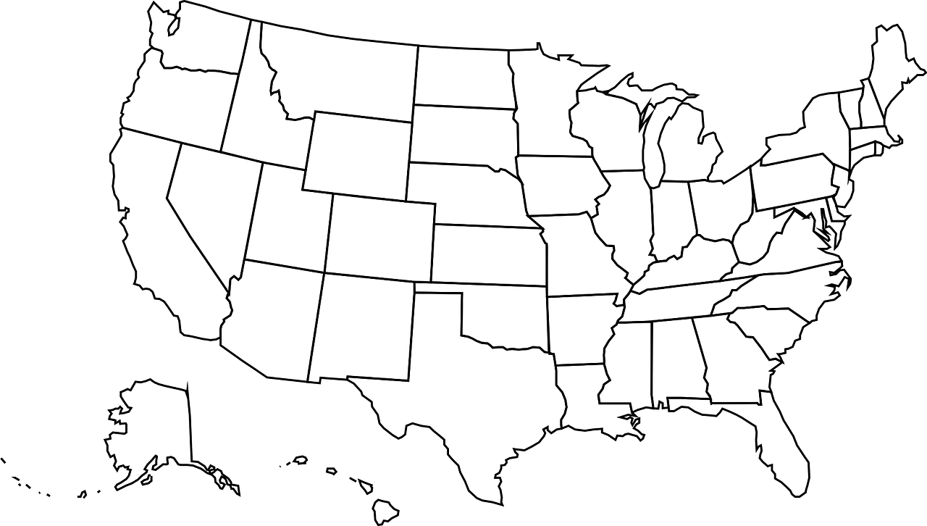

United States Headquarters/Production Centers
Auburn Hills, MI (HQ)
New Baltimore, MI
Danville, KY

Slide 15
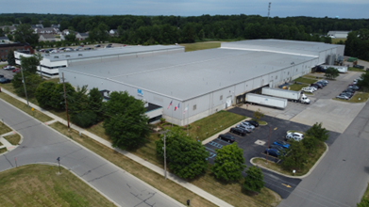
 | New Baltimore, Michigan | New Baltimore, Michigan
 | Surfaces (sq/ft) (m2) | Surfaces (sq/ft) (m²) |  | Employment
 | Workshop: 80,000 (7,300 m^2) Warehouses: 120,000 (10,700 m^2) | Workshop: 80,000 (7,300 m²) Warehouses: 120,000 (10,700 m²) | Total: 200,000 (18,000 m²) | 153 Employees
Activities
Thermoplastic Injection |  |  | Other Processes
Presses: 140 → 3900 T | Overmolding Gas Injection Sequential Injection |  | Welding Assembly Hot Stamping
Main Customers
T1 Auto | OEM Auto |  |  | Industry
Magna, Valeo, TI, Forvia, POCES | Stellantis, FORD, GM, TESLA, VOLVO TRUCKS |  |  | Target / Dematic
Quality Scope
ISO 9001 / IATF 16949/ ISO 14001

Slide 16
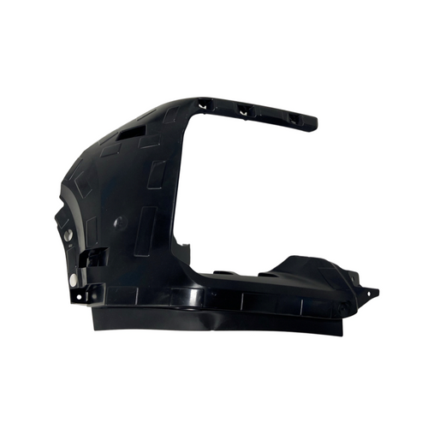
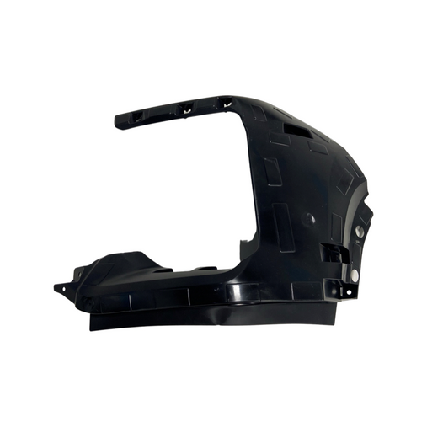
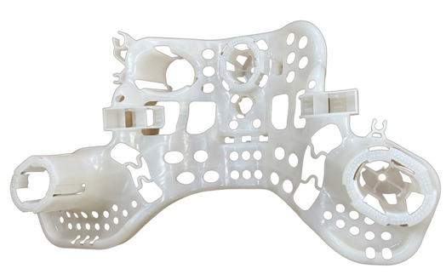
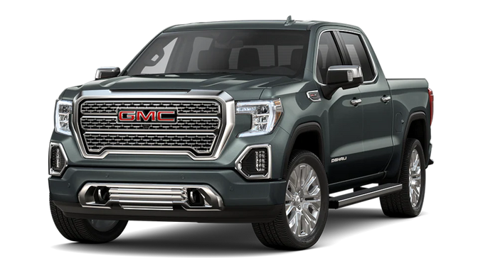
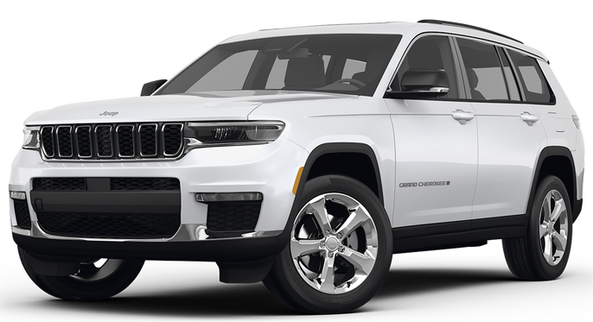
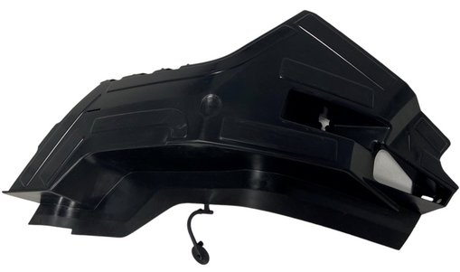
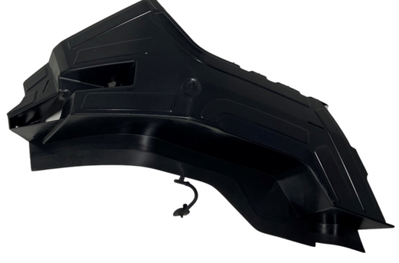
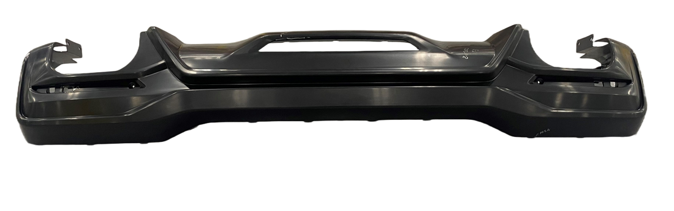
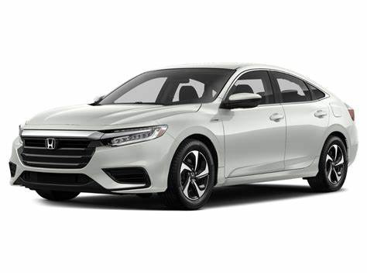
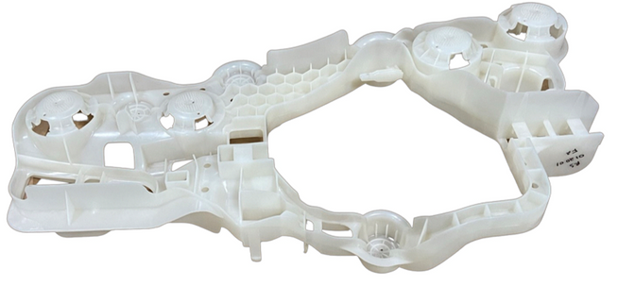
New Baltimore, Michigan - Exterior Parts

Slide 17
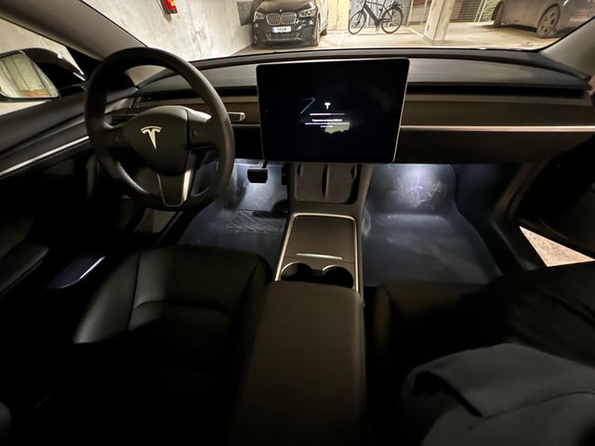
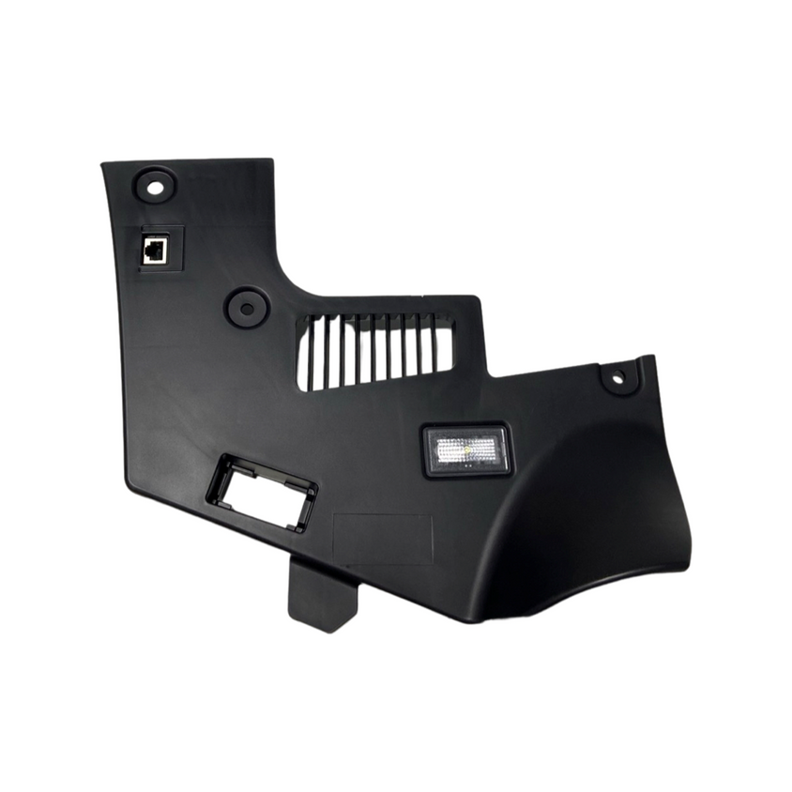
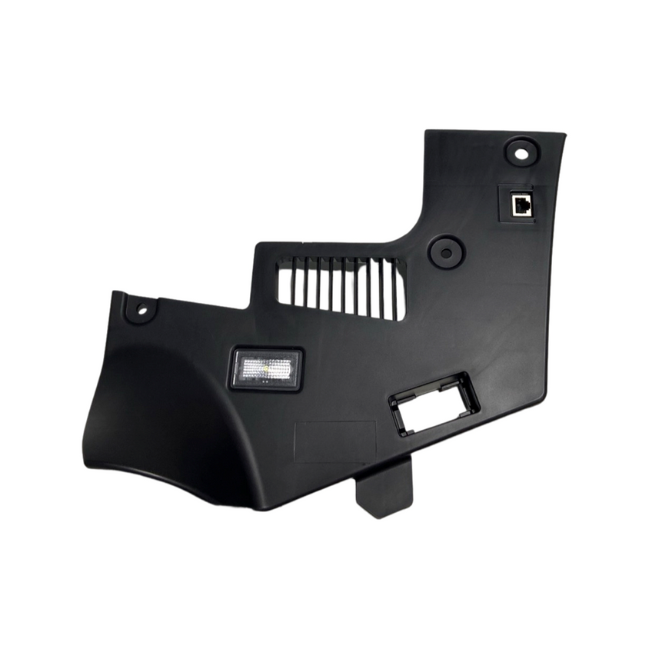
New Baltimore, Michigan - Interior Parts

Slide 18
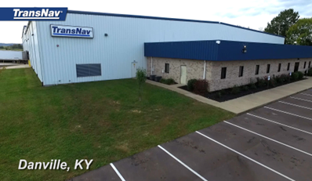
(waiting for updated picture) | Danville, Kentucky | Danville, Kentucky
 | Surfaces (sq/ft) (m2) | Surfaces (sq/ft) (m²) |  | Employment
 | Workshop: 44,000 (4,000 m^2) Warehouses: 56,000 (5,000 m^2) | Workshop: 44,000 (4,000 m²) Warehouses: 56,000 (5,000 m²) | Total: 100,000 (9,000 m²) | 110 Employees
Activities
Thermoplastic Injection |  |  | Other Processes
Presses: 110 → 1500 T | Overmolding |  | Assembly
Main Customers
T1 Auto | OEM Auto FCA, FORD, GM, TESLA, VOLVO TRUCKS |  | OEM Auto
Magna, Valeo, TI, Forvia, POCES, IPC |  |  | Stellantis, Ford, GM, Nissan, Toyota, VW
Quality Scope
ISO 9001 / IATF 16949/ISO 14001

Slide 19
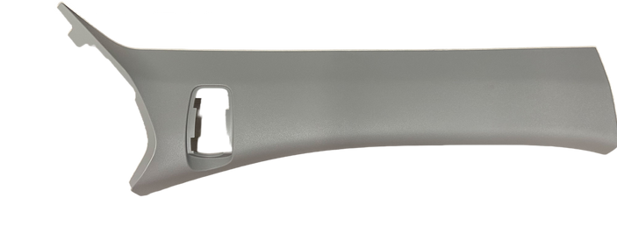
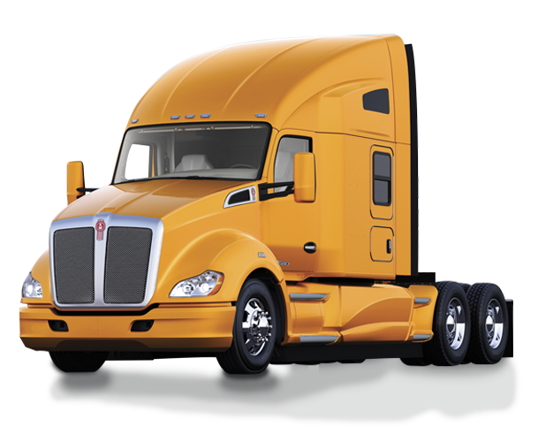
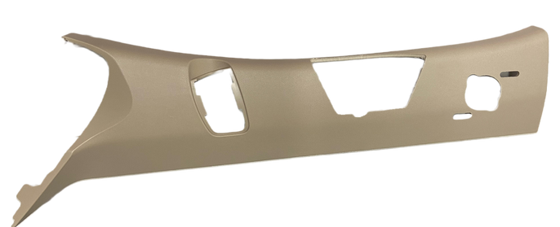
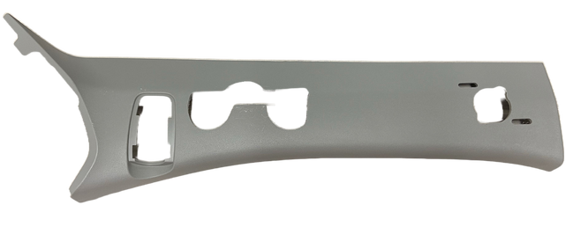
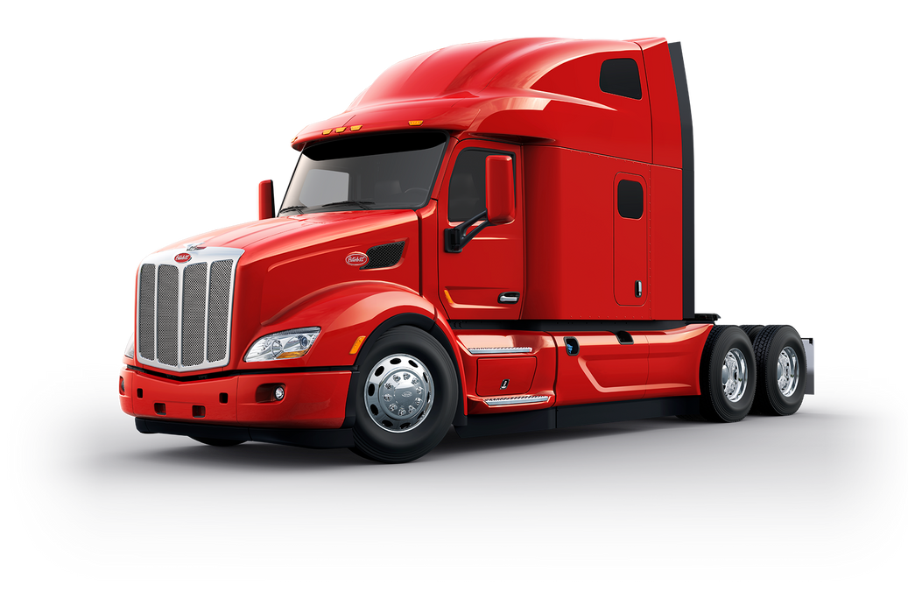
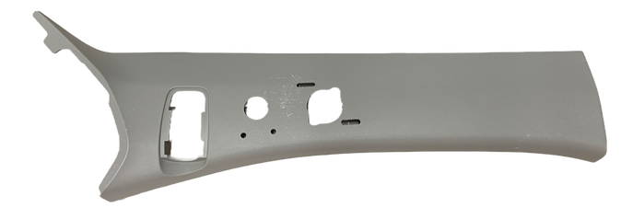
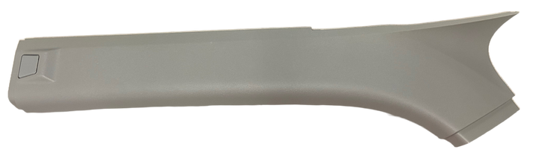
Danville, Kentucky - Interior Parts

Slide 20
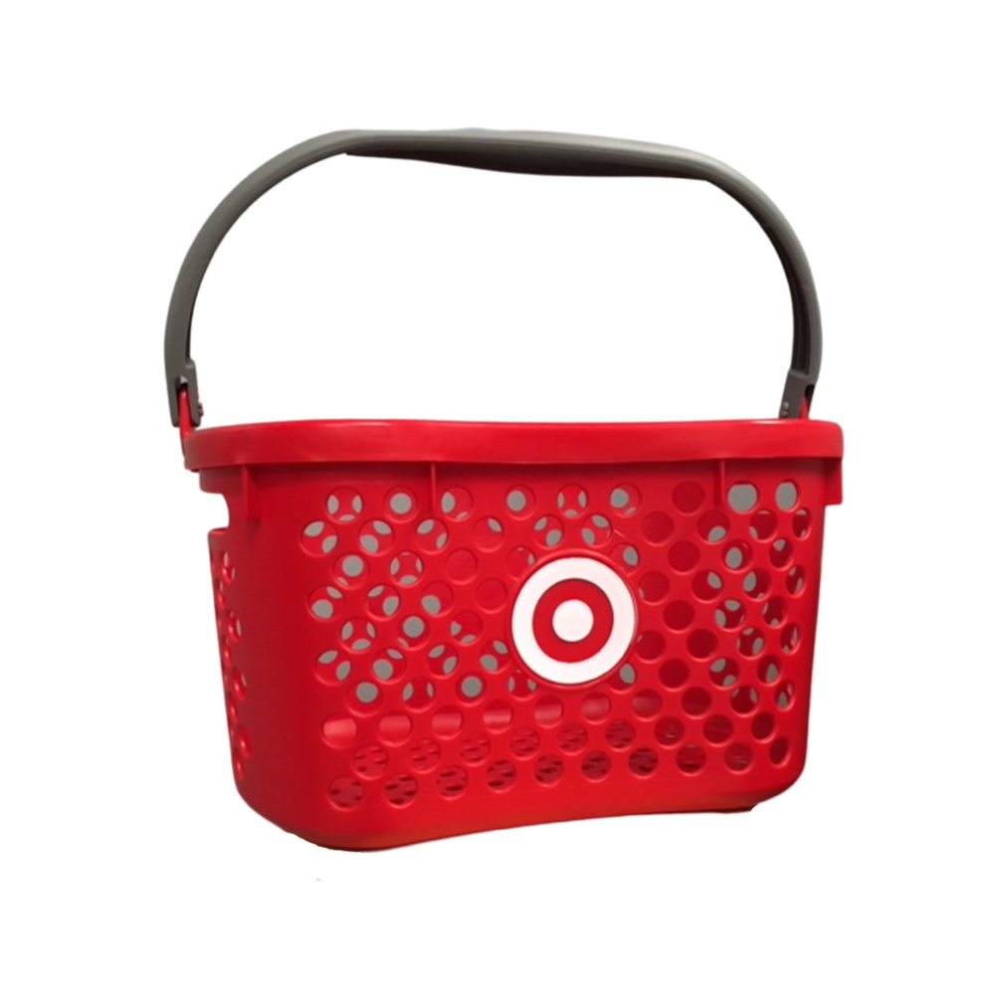

United States - Industrial
Manufactured in New Baltimore, Michigan
Manufactured in Danville, Kentucky

Slide 21
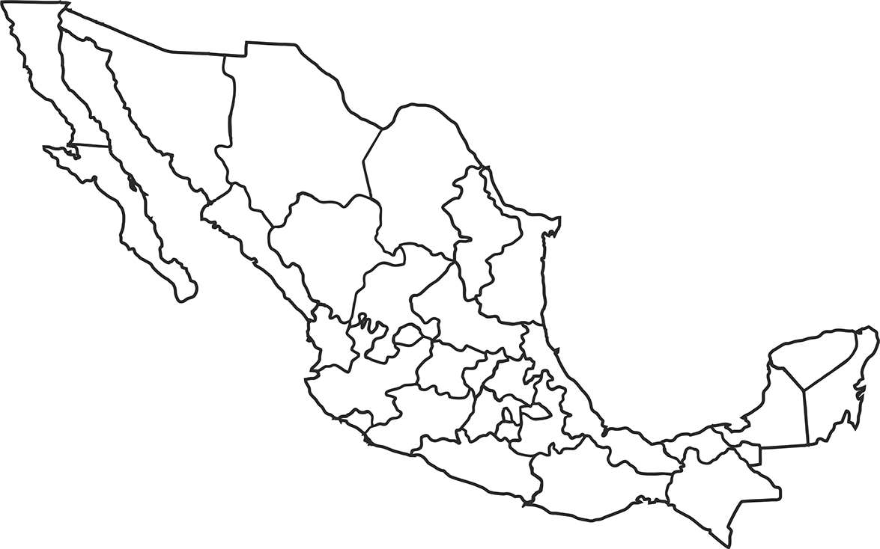
Mexico Production Centers
San Luis Potosí, Mexico
Puebla, Mexico

Slide 22
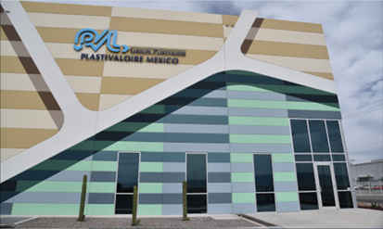
 | San Luis Potosí, Mexico | San Luis Potosí, Mexico
 | Surfaces (sq/ft) (m2) | Surfaces (sq/ft) (m²) |  | Employment
 | Workshop: 44,000 (4,000 m^2) Warehouses: 66,000 (10,700 m^2) | Workshop: 44,000 (4,000 m²) Warehouses: 66,000 (10,700 m²) | Total: 110,000 (10,000 m²) | 112 Employees
Activities
Thermoplastic Injection |  |  | Other Processes
Presses: 20 → 1500 T 2K Injection: 100 → 700 T | 2K Injection Hybrid Plastic Metal Low Pression Fabric |  | US Welding Assembly | Chrome Via BIA Mexico
Main Customers
T1 Auto | OEM Auto |  | OEM Auto | Industry
Valeo, HBPO, Draexlmaier |  |  | BMW, FCA, GM, Tesla
Quality Scope
ISO 9001 / IATF 16949/ ISO 14001

Slide 23
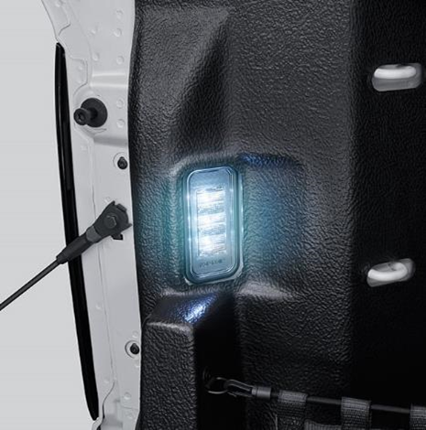
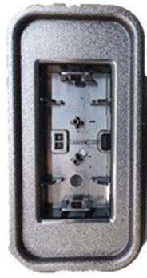







San Luis Potosí, Mexico - Exterior Parts

Slide 24






San Luis Potosí, Mexico- Exterior Parts

Slide 25






San Luis Potosí, Mexico - Interior Parts

Slide 26

 | Puebla, Mexico
 | Surfaces (sq/ft) (m²) |  | Employment
 | Workshop: 105,000 (9,500 m²) Warehouses: 105,000 (9,500 m²) | Total: 210,000 (19,000 m²) | 155 Employees
Activities
Thermoplastic Injection |  | Other Processes
Presses: 20 → 1500 T | Insert Molding Sequential Injection | Welding (mirror, US) Assembly Hot Stamping | Chrome Via BIA Mexico
Main Customers
T1 Auto | OEM Auto | OEM Auto | Industry
Forvia, POCES, Valeo, HBPO, BROSE, Eissmann, LEAR, TI |  | Audi, Stellantis, Ford, GM, Tesla, VW
Quality Scope
ISO 9001 / IATF 16949 / ISO 14001

Slide 27














Puebla, Mexico - Interior Parts

Slide 28








Puebla, Mexico - Exterior Parts

Slide 29
Company Objectives

Slide 30

ESG (Environment, Social, Governance)
  PVL has launched a Group project to boost its ESP initiative:
B2P
Blue Planet
Blue Project

Slide 31
-50% emissions for greenhouse effect
30% recycled raw materials used
-50% waste generated
65.1 Mt CO2 in 2021
10% in 2021 (67.1 Mt)
9.9 Mt in 2021
Environmental Objectives for 2023

Slide 32


Energy Transition and Sustainable Development
The Plastivaloire Group is increasingly committed to energy transition and sustainable development, signing an agreement with DTE Energy to supply 85% green energy to our New Baltimore, MI plant and PVL North America headquarters in Auburn Hills, MI. This will be achieved through the use of environmentally friendly solar and wind energies.

Slide 33








Global Innovation at PVL
Sustainability
Attractiveness
New Mobility
Weight Reduction
Sustainable Material & Components Environmental Regulations
Design & Comfort
New Energies
ADAS & Connected Cars
  Up to 20% weight reduction on visible parts
  Mucell / Foaming
  QSP (composite Polymer / fibers)
  Becoming increasingly important with the demand of electric vehicles
  Diversify the in-house decoration process
  Ambient lighting
  Fabrics with thermocompression
  Real wood with back injection
  Biobased & recycled materials
  Natural materials (wood, cork, etc.)
  Chrome 6 Free Etching
  PVD (alternative to chrome)
  New energy flaps
  Flush E-handles for E-access
  Integrated lighting in trim
  Smart Surface

Slide 34







Capabilities
Structured Chrome
Color

Slide 35






Plastivaloire
THANK YOU
@Plastivaloire
We look forward to working with you
Groupe Plastivaloire
For More Information Visit: www.groupe-plastivaloire.com

